Slide 1
Physical properties
Year 7 Science

Slide 2

Review
What do we mean by “property” in chemistry?
Explain the difference between a physical and a chemical property.
List 5 physical properties.
How could you measure transparency?
How could you measure melting point?

Slide 3
Learning Intentions
Mixtures, including solutions, contain a combination of pure substances that can be separated using a range of techniques.

Slide 4
Success criteria
Observe physical properties, such as melting point.
Investigate physical properties of oobleck.

Slide 5
Success criteria
Observe physical properties, such as melting point.
Investigate physical properties of oobleck.

Slide 6

Properties of matter
A property is a characteristic or feature of an object that distinguishes one substance from another.
A physical property can be measured or observed without changing the identity of the substance.

Slide 7
Physical properties include:
colour
texture
hardness
odour
physical state
malleability
elasticity
electrical conductivity
magnetism
density
volatility
transparency
solubility
melting and boiling point
taste
10:42 AM

Slide 8
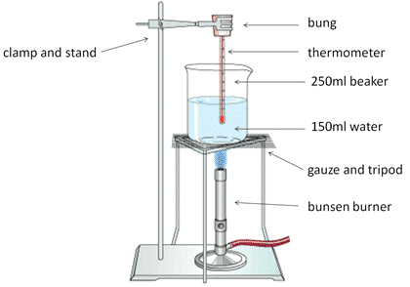
Activity: Melting point

Slide 9
Melting point of chocolate
Type of chocolate | Melting point (ºC)
White
Milk
Dark

Slide 10

Activity 2: Oobleck
Step 1: 110mL of water in a 500 or 600mL beaker.
Step 2: Add 5 drops of green food colouring
Step 3: Slowly add 1/3 cup of cornflour, stirring constantly with a PLASTIC stirring rod. Stop adding if it gets too thick before you have added it all.
Observe as many physical properties as you can.
Clean up and pack up.

